Slide 1
FINAL PRESENTATION
GUIDED BY:-
Ms. Dimple Bajaj
Assistant Professor
DIT University
PRESENTED BY:-
Abhishek Garg (1503021068)
Aditi (1503021012)
Happy Mittal (1503021022)

Slide 2
GET THROUGH APP

Slide 3
INDEX
Problem Statement
Objective of the project
Introduction
Significance
Project functions
Technology used
Tools used
Hardware and software requirement
E-R Diagram
Constraints and Assumptions
Scope for future work
Screenshots
Conclusion

Slide 4
PROBLEM STATEMENT
No Software present until now.
Time consumed in ordering food.
Time consumed in waiting in the queues for collecting uniforms.
Chances of losing bus pass or forgetting it at their home.
Manual existing system till now.

Slide 5
Objective Of the project
The project aims to fulfil following objectives :
Mainly designed to help thousands of people in DIT University for making day to day activities much easier.
Details about the food trucks and their menus and reduces time.
Carrying digital bus passes to reduce chances of forgetting or losing.

Slide 6
INTRODUCTION
It is a complete personal app that could benefit the people who need to save time.
The food sub-app will lead us to the screen where we are supposed to see details of the food trucks and their respective menu.
The uniform sub-app is explicitly made for the first year students to get the uniform on time by the Dress Camp.
In the bus pass sub-app, the users will be able to carry a digital bus pass. This will decrease the chances of forgetting the existing bus pass at home or the chances of losing their bus pass is also significantly reduced.

Slide 7
SIGNIFICANCE
Easy to use GUI.
It’s free of cost and can be accessed by anyone with an android Smartphone.
It is a scalable application i.e. more details can be added to its database later.
Application is really small in size and bug free.
Increased operational efficiency.

Slide 8
Reduce paperwork.
Reduced operational time.
Increased accuracy and reliability.
Students and faculties can register online and easily access uniform- and bus_pass- for the students and food- app for both.
It takes few minutes for providing details which is much faster than doing things manually.

Slide 9
PROJECT FUNCTION
The project allows a user to order food, book slots for uniform purchase and carry bus pass.
The user will be able to browse through the food items present in the database and order accordingly.
Users will also be able to carry the bus pass and issue a new one once the validity is over.
The user will also be also given a feature where user is also allowed to book slots according to their time preferences.

Slide 10
Technology used
XML (Extensible Markup Language)
XML is a software- and hardware-independent tool for storing and transporting data. The design
Goals of XML emphasize simplicity, generality, and usability across the Internet.
JAVA
Java is a general-purpose computer-programming language that is concurrent, class-based, object-oriented, and specifically designed to have as few implementation dependencies as possible.

Slide 11
TOOLS USED
ANDROID STUDIO
Android Studio is the official IDE for android application development. It works based on IntelliJ IDE.
ADOBE PHOTOSHOP
An image editing software developed and manufactured by Adobe Systems Inc. Photoshop is considered as one of the leaders in photo editing software.
The software allows users to manipulate, crop, resize, and correct color on digital photos.

Slide 12
HARDWARE AND SOFTWARE REQUIREMENTS
HARDWARE REQUIREMENTS
6 GB RAM minimum, 8 GB RAM recommended
500 MB disk space
At least 1 GB for Android SDK, emulator system images, and caches
1280x800 minimum screen resolution
SOFTWARE REQUIREMENTS
Android Studio, Adobe Photoshop.
MySQL.
Java Development Kit (JDK) 7 or higher

Slide 13
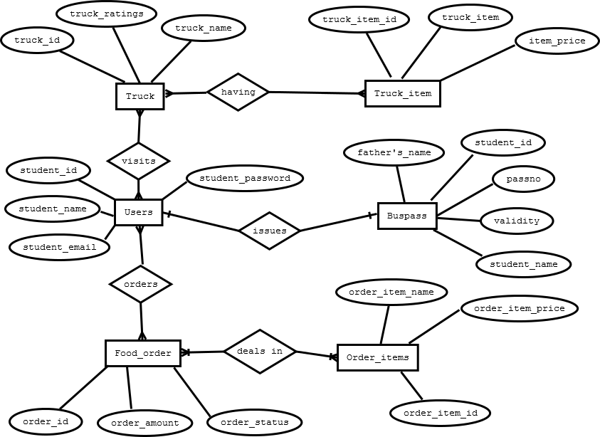
E-R DIAGRAM

Slide 14
CONSTRAINTS AND ASSUMPTIONS
Constraints
The user must be connected over the network before operating the appliance.
The mobile application is limited only to android OS.
The version of Android Smartphone used must be greater than 4.0.3.
Assumptions
The user will operate the appliance only when he/she is logged in.
The user will order food from only one bus at a time.
The user will issue a single bus pass from his account.
The user is smart enough to operate an android application.
The user knows how to connect to internet.

Slide 15
SCOPE FOR FUTURE WORK
We could integrate an app for sprint usage. Since most of the students prefers Sprint for print related work and other activities which may be proved useful in daily routine.
We could extend this app for numerous college related activities which can be made quick and easy by following this rather than the conventional method.

Slide 16
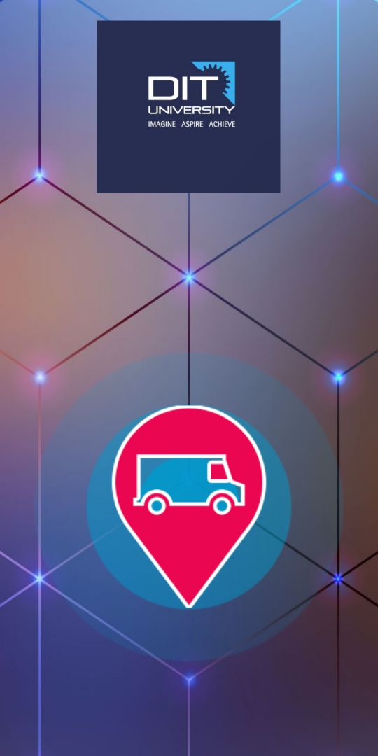
SCREENSHOT

Slide 17
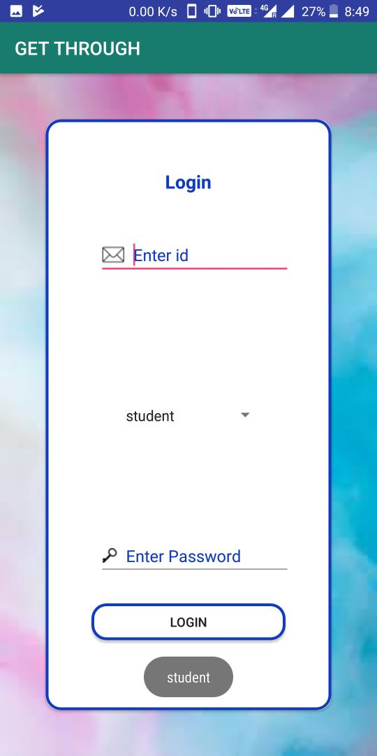

Slide 18
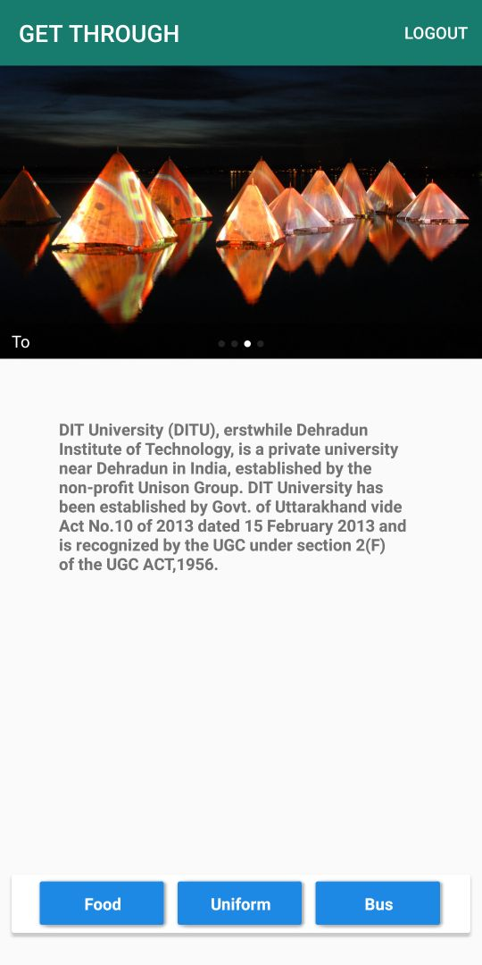

Slide 19
CONCLUSION
This Project aims to fulfil the requirement of the students , the faculty members of the University with the use of latest technology in trend to its best and produce the best possible results to be able to penetrate into daily routines of University.

Slide 20
THANK YOU!

